Slide 1
Chapter 15:
Advanced GUI Topics

Slide 2
Objectives
Use content panes
Use color
Learn more about layout managers
Use JPanels to increase layout options
Create JScrollPanes
Java Programming, Eighth Edition

Slide 3
Objectives (cont’d.)
Understand events and event handling more thoroughly
Use the AWTEvent class methods
Handle mouse events
Use menus
Java Programming, Eighth Edition

Slide 4
Understanding the Content Pane
Top-level container
  JFrame
  Contains a content pane, menu bar, and glass pane
Containment hierarchy
  A tree of components that has a top-level container as its root
Content pane
  Contains all the visible components in the container’s user interface
Java Programming, Eighth Edition

Slide 5
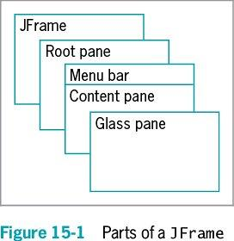
Understanding the Content Pane (cont’d.)
Java Programming, Eighth Edition

Slide 6
Understanding the Content Pane (cont’d.)
  getContentPane() method
  You can add components directly to JFrames without explicitly calling getContentPane() using the add() method
    You can use the remove() and setLayout() methods also
  Other methods must use getContentPane()
    setBackground()
Java Programming, Eighth Edition

Slide 7
Using Color
Color class
  Defines colors for you to use in your applications
  Use with setBackground() and setForeground()
  Defines named constants that represent 13 colors
Create your own Color object
  Color someColor = new Color(r, g, b);
Discover the red, green, or blue components of any existing color with getRed(), getGreen(), and getBlue()
Java Programming, Eighth Edition

Slide 8
Learning More About Layout Managers
Layout manager
  Controls the size and position of components inside a Container object
  Determines how the components are sized and positioned within it
  Is an interface class that is part of Java SDK
  Aligns components so that they do not:
    Crowd each other
    Overlap
Java Programming, Eighth Edition

Slide 9
Learning More About Layout Managers (cont’d.)
Layout manager (cont’d.)
  Arranges components within a Container
    Each component you place within a Container can also be a Container itself
    You can assign layout managers within layout managers
Java platform–supplied layout managers
  FlowLayout and GridLayout
  BorderLayout and CardLayout
  GridBagLayout and BoxLayout
Java Programming, Eighth Edition

Slide 10
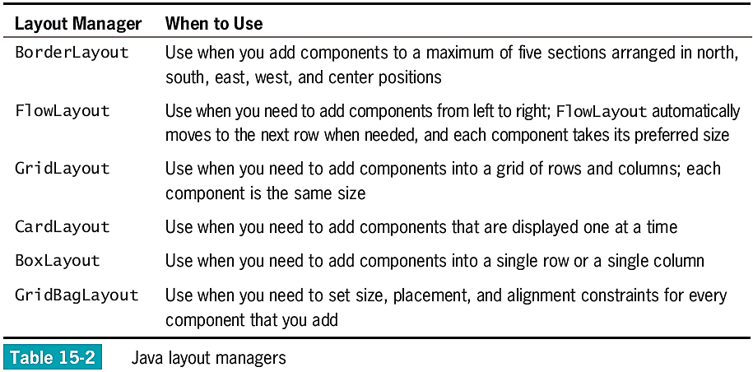
Learning More About Layout Managers (cont’d.)
Java Programming, Eighth Edition

Slide 11
Using BorderLayout
BorderLayout manager
  The default for all content panes
  Use with any container that has five or fewer components
    Component containers can hold more components
  Components fill the screen in five regions:
    North
    South
    East
    West
    Center
Java Programming, Eighth Edition

Slide 12
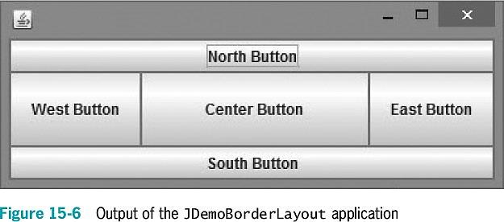
Using BorderLayout (cont’d.)
Java Programming, Eighth Edition

Slide 13
Using FlowLayout
FlowLayout manager
  Arranges components in rows across the width of a Container
  When you add a Component:
    It is placed to the right of previously added components in a row
    If the current row is filled, the Component is placed to start a new row
  Each Component retains its preferred size
Java Programming, Eighth Edition

Slide 14
Using FlowLayout (cont’d.)
You can use three constants to align Components with a Container:
  FlowLayout.LEFT
  FlowLayout.CENTER
  FlowLayout.RIGHT
If the alignment is not specified, Components are center-aligned
Java Programming, Eighth Edition

Slide 15
Using FlowLayout (cont’d.)
invalidate()
  Marks the container as needing to be laid out
validate()
  Causes components to be rearranged based on the newly assigned layout
Java Programming, Eighth Edition

Slide 16
Using GridLayout
GridLayout manager class
  Arranges components into equal rows and columns
When you create a GridLayout object:
  Indicate the numbers of rows and columns
    Specify rows first and then columns
  The container surface is divided into a grid
The following statement establishes a GridLayout:
  con.setLayout(new GridLayout(4, 5));
Java Programming, Eighth Edition

Slide 17
Using GridLayout (cont’d.)
The following statement establishes a GridLayout with three horizontal rows, two vertical columns, and vertical gaps of five pixels each:
  private GridLayout layout = new GridLayout(3, 2, 5, 5);
You can use 0 for the number of columns or rows
Java Programming, Eighth Edition

Slide 18
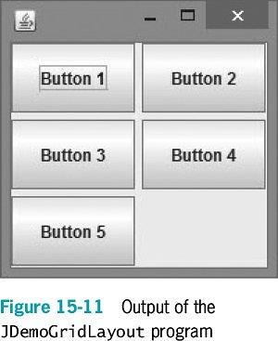
Using GridLayout (cont’d.)
Java Programming, Eighth Edition

Slide 19
Using CardLayout
CardLayout manager
  Generates a stack of containers or components one on top of another
  Each component in the group is referred to as a card
  Multiple components share the same display space
Java Programming, Eighth Edition

Slide 20
Using CardLayout (cont’d.)
To create a card layout, use one of two constructors:
  CardLayout()
    Creates a card layout without a horizontal or vertical gap
  CardLayout(int hgap, int vgap)
    Creates a card layout with the specified horizontal and vertical gaps
  To add a component to a content pane, use:
    add(aString, aContainer);
Java Programming, Eighth Edition

Slide 21
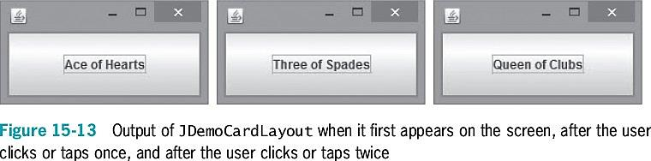
Using CardLayout (cont’d.)
Java Programming, Eighth Edition

Slide 22
Using Advanced Layout Managers
GridBagLayout manager
  Adds Components to precise locations within the grid
  Indicates that specific Components should span multiple rows or columns within the grid
  You must set the position and size for each component
  You must customize one or more GridBagConstraints objects
BoxLayout manager
  Allows multiple components to be laid out either vertically or horizontally
Java Programming, Eighth Edition

Slide 23
Using the JPanel Class
JPanel
  A plain, borderless surface
  Can hold lightweight UI components
Double buffering
  Additional memory space will be used to draw the JPanel offscreen when it is updated
Java Programming, Eighth Edition

Slide 24
Using the JPanel Class (cont’d.)
Constructors
  JPanel()
  JPanel(LayoutManager layout)
  JPanel(Boolean isDoubleBuffered)
  JPanel(LayoutManager layout, Boolean isDoubleBuffered)
To add a component to JPanel:
  Call the container’s add() method
  Use the component as an argument
Java Programming, Eighth Edition

Slide 25
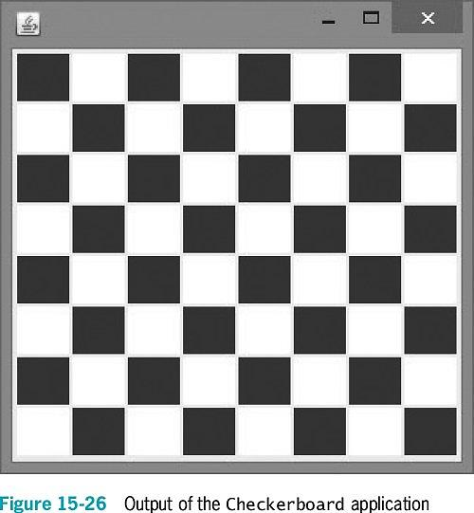
Using the JPanel Class (cont’d.)
Java Programming, Eighth Edition

Slide 26
Creating JScrollPanes
JScrollPane
  Provides scroll bars along the side or bottom of a pane
  Enables the user to scroll initially invisible parts of the pane into view
Constructors
  JScrollPane()
  JScrollPane(Component)
  JScrollPane(Component, int, int)
  JScrollPane(int, int)
Java Programming, Eighth Edition

Slide 27
Creating JScrollPanes (cont’d.)
To force the display of the scroll bar, use the following ScrollPaneConstants class variables:
  ScrollPaneConstants.HORIZONTAL_SCROLLBAR_AS_NEEDED
  ScrollPaneConstants.HORIZONTAL_SCROLLBAR_ALWAYS
  ScrollPaneConstants.HORIZONTAL_SCROLLBAR_NEVER
  ScrollPaneConstants.VERTICAL_SCROLLBAR_AS_NEEDED
  ScrollPaneConstants.VERTICAL_SCROLLBAR_ALWAYS
  ScrollPaneConstants.VERTICAL_SCROLLBAR_NEVER
Java Programming, Eighth Edition

Slide 28
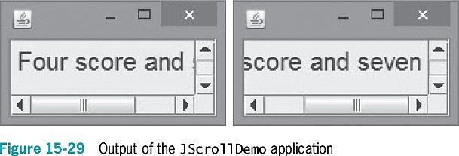
Creating JScrollPanes (cont’d.)
Java Programming, Eighth Edition

Slide 29
A Closer Look at Events and Event Handling
Events
  Objects that the user initiates
EventObject
  The parent class for all event objects
  Descends from the Object class
  The parent of the AWTEvent class
    AWTEvent is the parent of ActionEvent and ComponentEvent
Java Programming, Eighth Edition

Slide 30
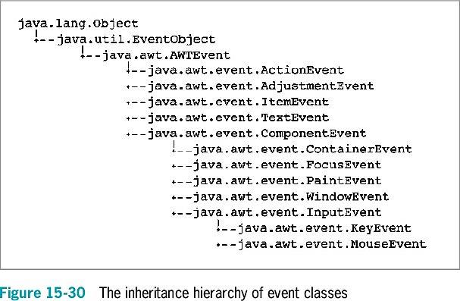
A Closer Look at Events and Event Handling (cont’d.)
Java Programming, Eighth Edition

Slide 31
A Closer Look at Events and Event Handling (cont’d.)
ActionEvents
  Focus on changes in a component
MouseEvents
  Focus on what the user does manually with the mouse
The computer’s operating system notifies the user when an AWTEvent occurs
  You can ignore AWTEvents
  You must implement an appropriate interface for your class to receive events
Java Programming, Eighth Edition

Slide 32
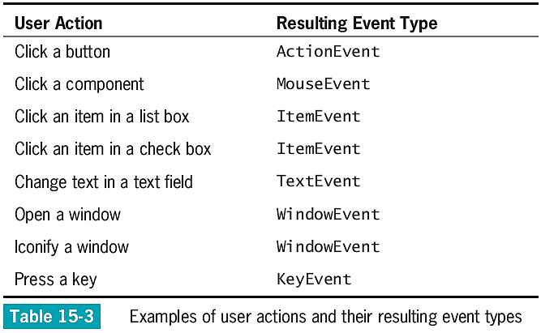
A Closer Look at Events and Event Handling (cont’d.)
Java Programming, Eighth Edition

Slide 33
A Closer Look at Events and Event Handling (cont’d.)
Event handler
  An interface method such as actionPerformed()
  Called automatically when an appropriate event occurs
Adapter class
  Implements all methods in an interface
    Provides an empty body for each method
When you extend the adapter class, you need to write only the methods you want to use
  Do not bother creating empty methods for the others
Java Programming, Eighth Edition

Slide 34
A Closer Look at Events and Event Handling (cont’d.)
You create an event handler when you write code for the listener methods
  Tell the class how to handle events
You must register an instance of the class with the component that the event affects
  For any <name>Listener, use:
  object.add<name>Listener(Component)
Java Programming, Eighth Edition

Slide 35
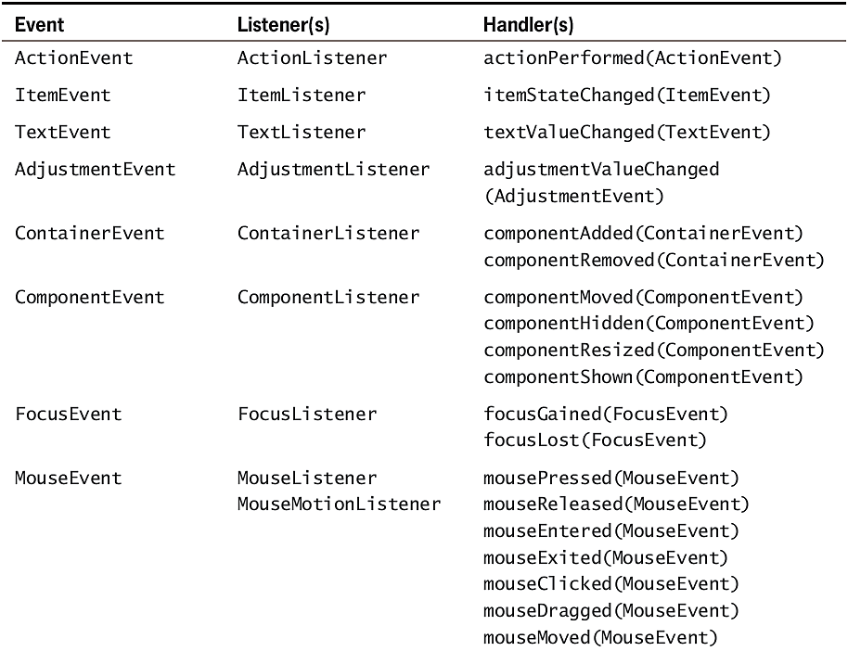
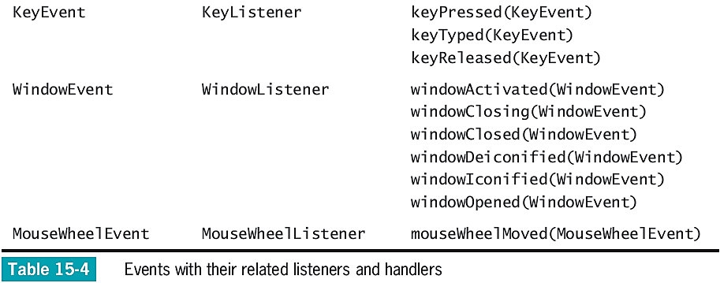
Java Programming, Eighth Edition

Slide 36
An Event-Handling Example: KeyListener
KeyListener interface
  Use to receive actions that the user initiates from the keyboard
KeyListener contains three methods:
  keyPressed()
  keyTyped()
    Use to discover which character was typed
    Does not execute calls from action keys
  keyReleased()
    Does not take action while the user holds down the key
Java Programming, Eighth Edition

Slide 37
An Event-Handling Example: KeyListener (cont’d.)
KeyEvent class
  Contains virtual key codes
    Represent keyboard keys that have been pressed
    Virtual key code constants have names such as VK_SHIFT and VK_ALT
Java Programming, Eighth Edition

Slide 38
Using AWTEvent Class Methods
AWTEvent classes
  Contain methods that return information about an event
  All Components have these methods:
    addComponentListener()
    addFocusListener()
    addMouseListener()
    addMouseMotionListener()
Java Programming, Eighth Edition

Slide 39
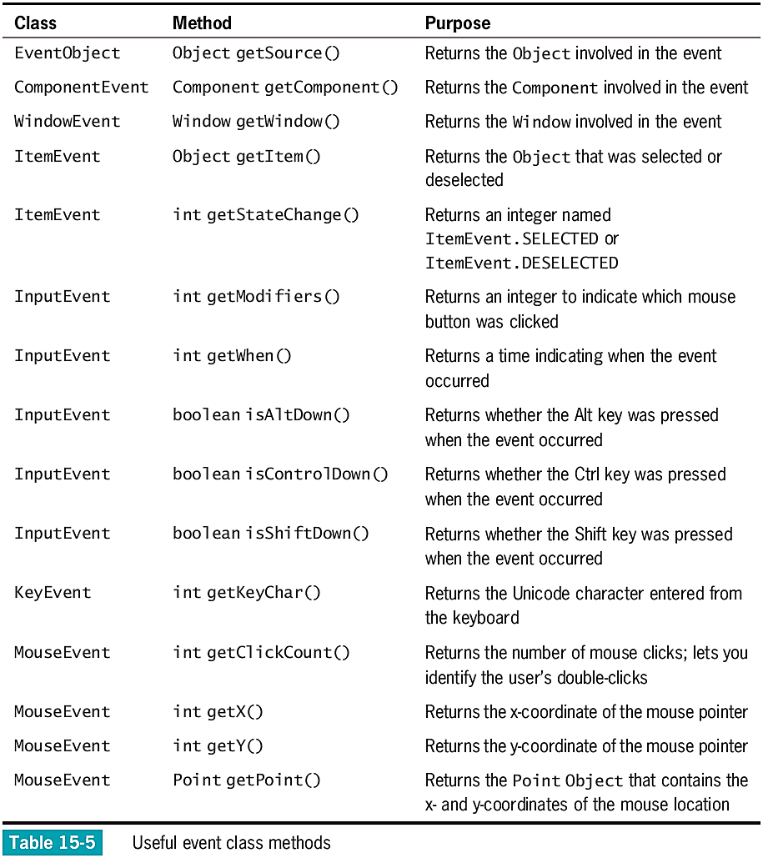
Java Programming, Eighth Edition

Slide 40
Using AWTEvent Class Methods (cont’d.)
To call Event class methods, use the
object-dot-method format
  For example, if you have a KeyEvent named inputEvent and an integer named unicodeVal, the following statement is valid:
    unicodeVal = inputEvent.getKeyChar();
When you use an event object within a handler method to obtain information, add a dot and the appropriate method name
When you use an event, you can use any methods that belong to any superclass of the event
Java Programming, Eighth Edition

Slide 41
Understanding x- and y-Coordinates
x-axis
  Horizontal position
y-axis
  Vertical position
0, 0
  Upper-left corner of any display
x-coordinate
y-coordinate
Java Programming, Eighth Edition

Slide 42
Handling Mouse Events
MouseMotionListener interface
  mouseDragged() and mouseMoved()
    Detect the mouse being rolled or dragged across a component surface
MouseListener interface
  mousePressed(), mouseClicked(), and mouseReleased()
    Analogous to keyboard event methods
  mouseEntered() and mouseExited()
    Inform you when the user positions the mouse over a component (entered) or moves the mouse off a component (exited)
Java Programming, Eighth Edition

Slide 43
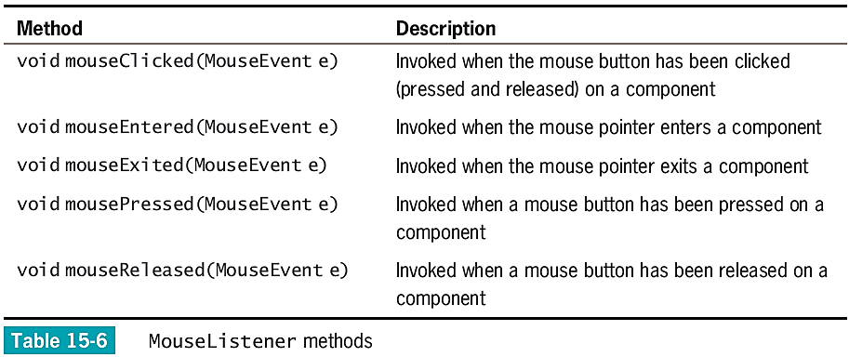
Handling Mouse Events (cont’d.)
Java Programming, Eighth Edition

Slide 44
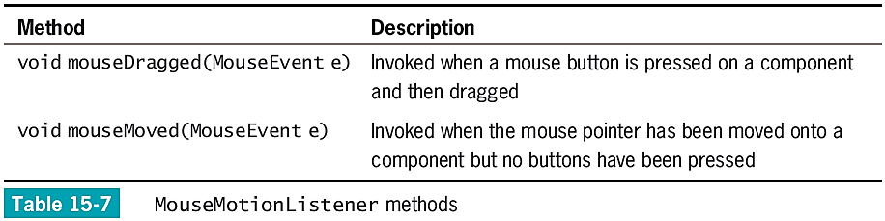
Handling Mouse Events (cont’d.)
Java Programming, Eighth Edition

Slide 45
Handling Mouse Events (cont’d.)
MouseInputListener interface
  Implements all methods in both MouseListener and MouseMotionListener interfaces
  Has no methods of its own
  Handles many different types of mouse events
MouseEvent
  The type of event generated by mouse manipulation
  Contains instance methods and fields
    Useful in describing mouse-generated events
Java Programming, Eighth Edition

Slide 46
Using Menus
Menus
  Lists of user options
Classes:
  JMenuBar
  JMenu
  JMenuItem
setJMenuBar() method
  Adds the JMenuBar to a JFrame
add() method
  Adds the JMenu to the JMenuBar
Java Programming, Eighth Edition

Slide 47
Using Specialized Menu Items
JCheckBoxMenuItem objects appear with a check box next to them
JRadioButtonMenuItem objects appear with a round radio button next to them
isSelected() method
  Determines the state of a JCheckBoxMenuItem or JRadioButtonMenuItem
Java Programming, Eighth Edition

Slide 48
Using addSeparator()
Adds a horizontal line to menus in order to visually separate groups for your users
Does not change the functionality of the menu
Java Programming, Eighth Edition

Slide 49
Using setMnemonic()
Mnemonic
  A key that causes an already-visible menu item to be chosen
setMnemonic() method
  Provides a shortcut menu key for any visible menu item
  Use a different mnemonic for each menu item
Accelerator
  A key combination that causes a menu item to be chosen, whether or not it is visible
  Only leaf menu items can have accelerators
Java Programming, Eighth Edition

Slide 50
You Do It
Using BorderLayout
Using Fewer than Five Components with the BorderLayout Manager
Using FlowLayout
Using GridLayout
Using CardLayout
Viewing All the Cards in CardLayout
Using a Menu Bar and JPanels
Java Programming, Eighth Edition

Slide 51
Don’t Do It
Don’t forget that the content pane is operating behind the scenes
Don’t forget that when you create a custom Color object, 0 represents the darkest shade and 255 represents the lightest
Don’t forget to set a layout manager
Don’t forget to use a region when adding a component to a BorderLayout
Java Programming, Eighth Edition

Slide 52
Don’t Do It (cont’d.)
Don’t use add() to place a JFrame’s menu bar
Don’t use the same mnemonic for multiple menu items
Java Programming, Eighth Edition

Slide 53
Summary
Layout manager
  An object that controls the size and position of components inside a Container object
    BorderLayout
    FlowLayout
    GridLayout
    CardLayout
    GridBagLayout
Use JPanels within other JPanels
  Create an infinite variety of screen layouts
Java Programming, Eighth Edition

Slide 54
Summary (cont’d.)
Events are Objects that the user initiates
Implement the appropriate listener interface for your class
Event handlers
  Interface methods automatically called when an event occurs
KeyListener interface
  Handles keyboard events
MouseListener interface
  Handles mouse events
Java Programming, Eighth Edition

